Slide 1
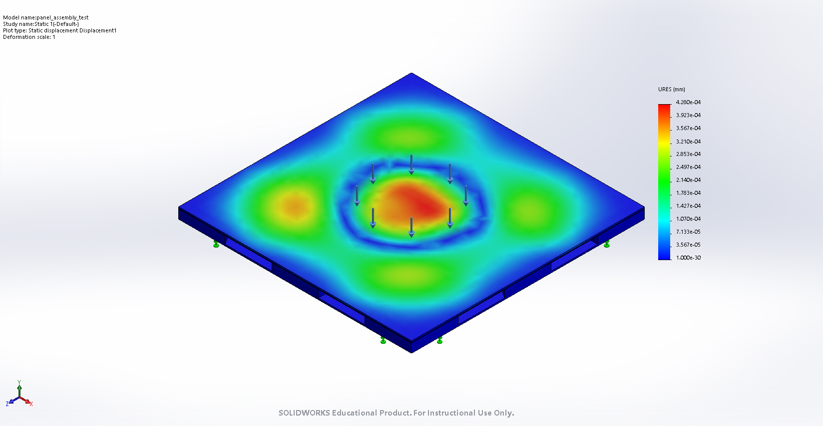
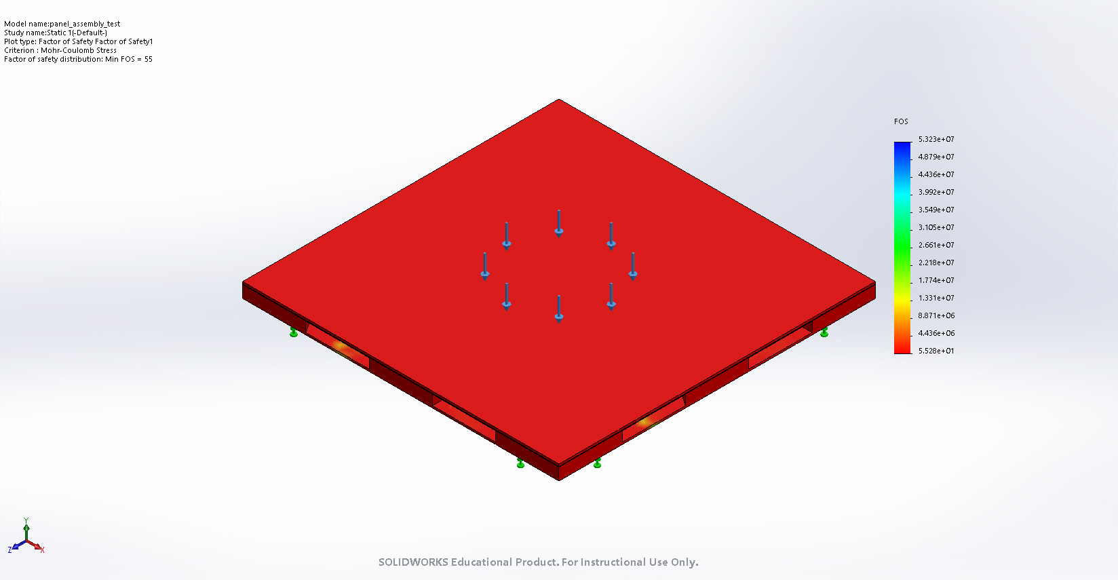




Validation
Structural Simulation
Luis, Nathan
4/16/21
Ran Full Assembly Compression Simulation
Fixed bottom (flat surface)
486 N Centered Circular Load
Dimensions: 15 x 15 cm
Top Plate: Zirconia
Bottom Plate: Macor
Elements ~ 13655
Nodes ~ 26673
Missing Constants on Data Sheets
Displacement
Max – 4e-4 mm
Factor of Safety
Min - 55

Slide 2
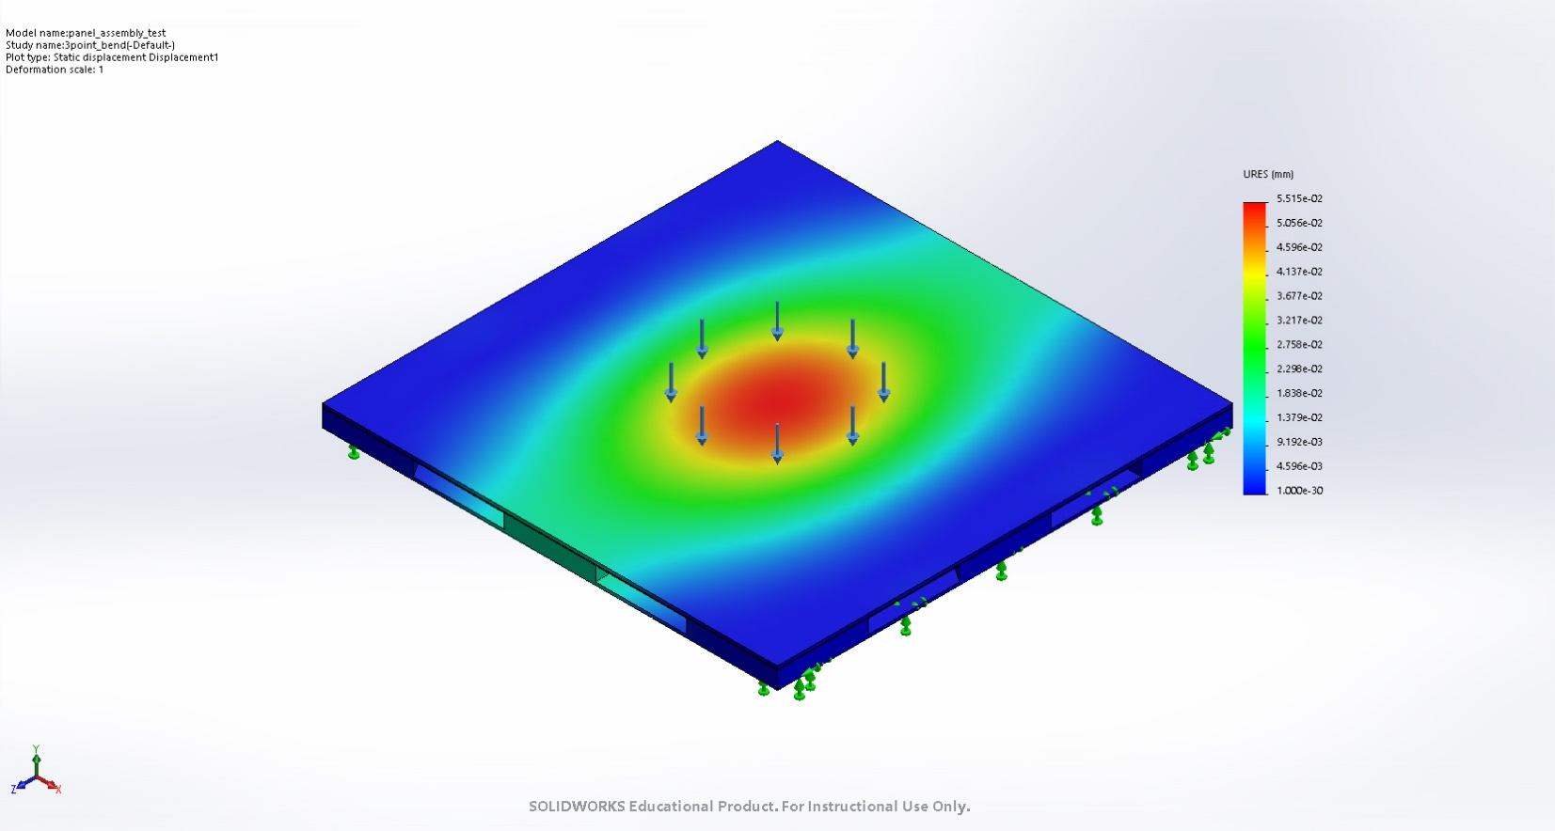
Validation
Structural Simulation
Luis, Nathan
4/16/21
Ran Full Assembly “3-point bend” Simulation
Fixed 10% of panel on opposite sides (flat surface)
486 N Centered Circular Load
Dimensions: 15 x 15 cm
Top Plate: Zirconia
Bottom Plate: Macor
Elements ~ 43100
Nodes ~ 83089
Missing Constants on Data Sheets
Displacement
Max – 5.52e-2 mm
Factor of Safety
Min – 2.79

